Slide 1
High Expectations (With Supports . . .) By Dave Dau

Slide 2
Look at the following pictures.

Slide 3
Look at the following pictures.
What do they have in common?

Slide 4
Look at the following pictures.
What do they have in common?
How do they make you feel?

Slide 5
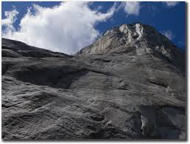

Slide 6
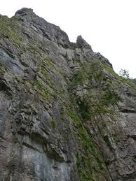

Slide 7
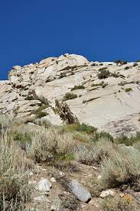

Slide 8
What do they have in common?

Slide 9
How do they make you feel?

Slide 10
Now look at these pictures . . .

Slide 11
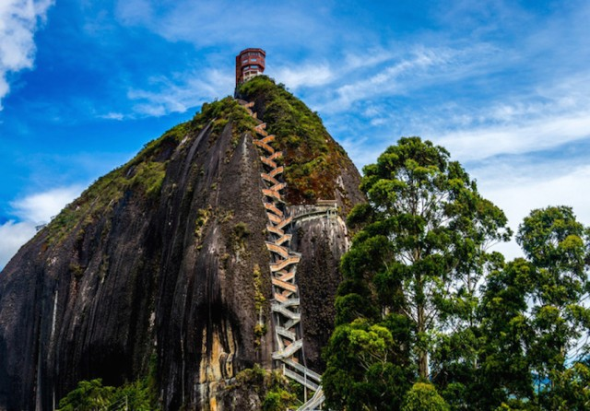

Slide 12
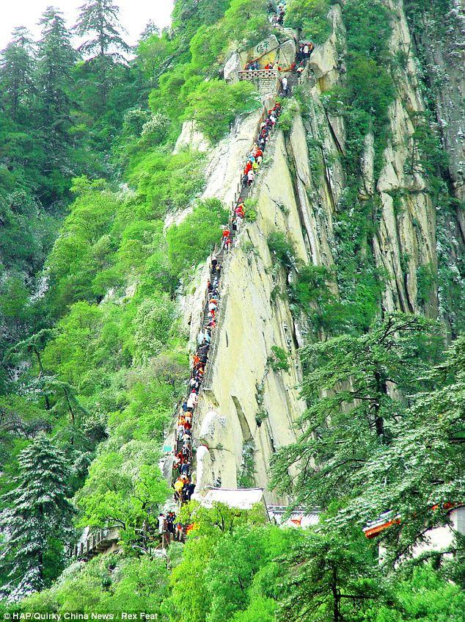

Slide 13
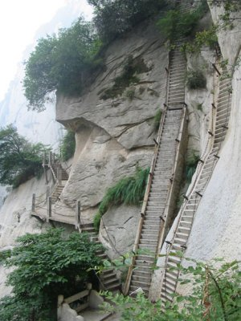

Slide 14
What did you notice?

Slide 15
What did you notice?
What did all of the images have in common?

Slide 16
What did you notice?
What did the first set of images have in common?

Slide 17
What did you notice?
How did they differ from the second set of images?

Slide 18
What did you notice?
Was there an “implied goal” in the last three pictures?

Slide 19
What did you notice?
Could we consider this “implied goal” a “high expectation?”

Slide 20
What did you notice?
What was the significance of the stairs?

Slide 21
As a teacher, it is good to have high expectations.

Slide 22
As a teacher, it is good to have high expectations.
But they are not enough.

Slide 23
As a teacher, it is good to have high expectations.
But they are not enough.
You also need to . . .

Slide 24
“know the mountain.”

Slide 25
“map the mountain.”

Slide 26
“build the steps
up the mountain.”

Slide 27
“prepare yourself
to climb the mountain.”

Slide 28
“prepare your students
to climb the mountain.”

Slide 29
Then,

Slide 30
Then,
when you lead your students up that mountain,

Slide 31
Then,
when you lead your students up that mountain,
at every step,

Slide 32
Then,
when you lead your students up that mountain,
at every step,
make sure

Slide 33
Then,
when you lead your students up that mountain,
at every step,
make sure
they are still with you.

Slide 34
Or,

Slide 35
Or,
when you get to the top of the mountain,

Slide 36
Or,
when you get to the top of the mountain,
you may find yourself

Slide 37
. . . alone.

Slide 38
A Philosophical Example

Slide 39
An Academic Example

Slide 40
Another Academic Example

Slide 41
Thanks!

